Slide 1

Big-data analytics
Covid-19 | Using hadoop
Project by: Akshaya Kumar Puvvada Monika Bondala
Haswanth Tummala
DASC – 5433 Research topics in CIS (Big Data Analytics) Instructor – Dr. Yalong Wu

Slide 2
Main Goals
Number of cases registered as per age group
Number of deaths as per age group – Death rate
Number of covid cases in different states
Number of deaths in each state

Slide 3
Analysis of data
Data is available at CDC website. (Data from CDC)
Number of rows available 102 Million
Number of columns available 19

Slide 4
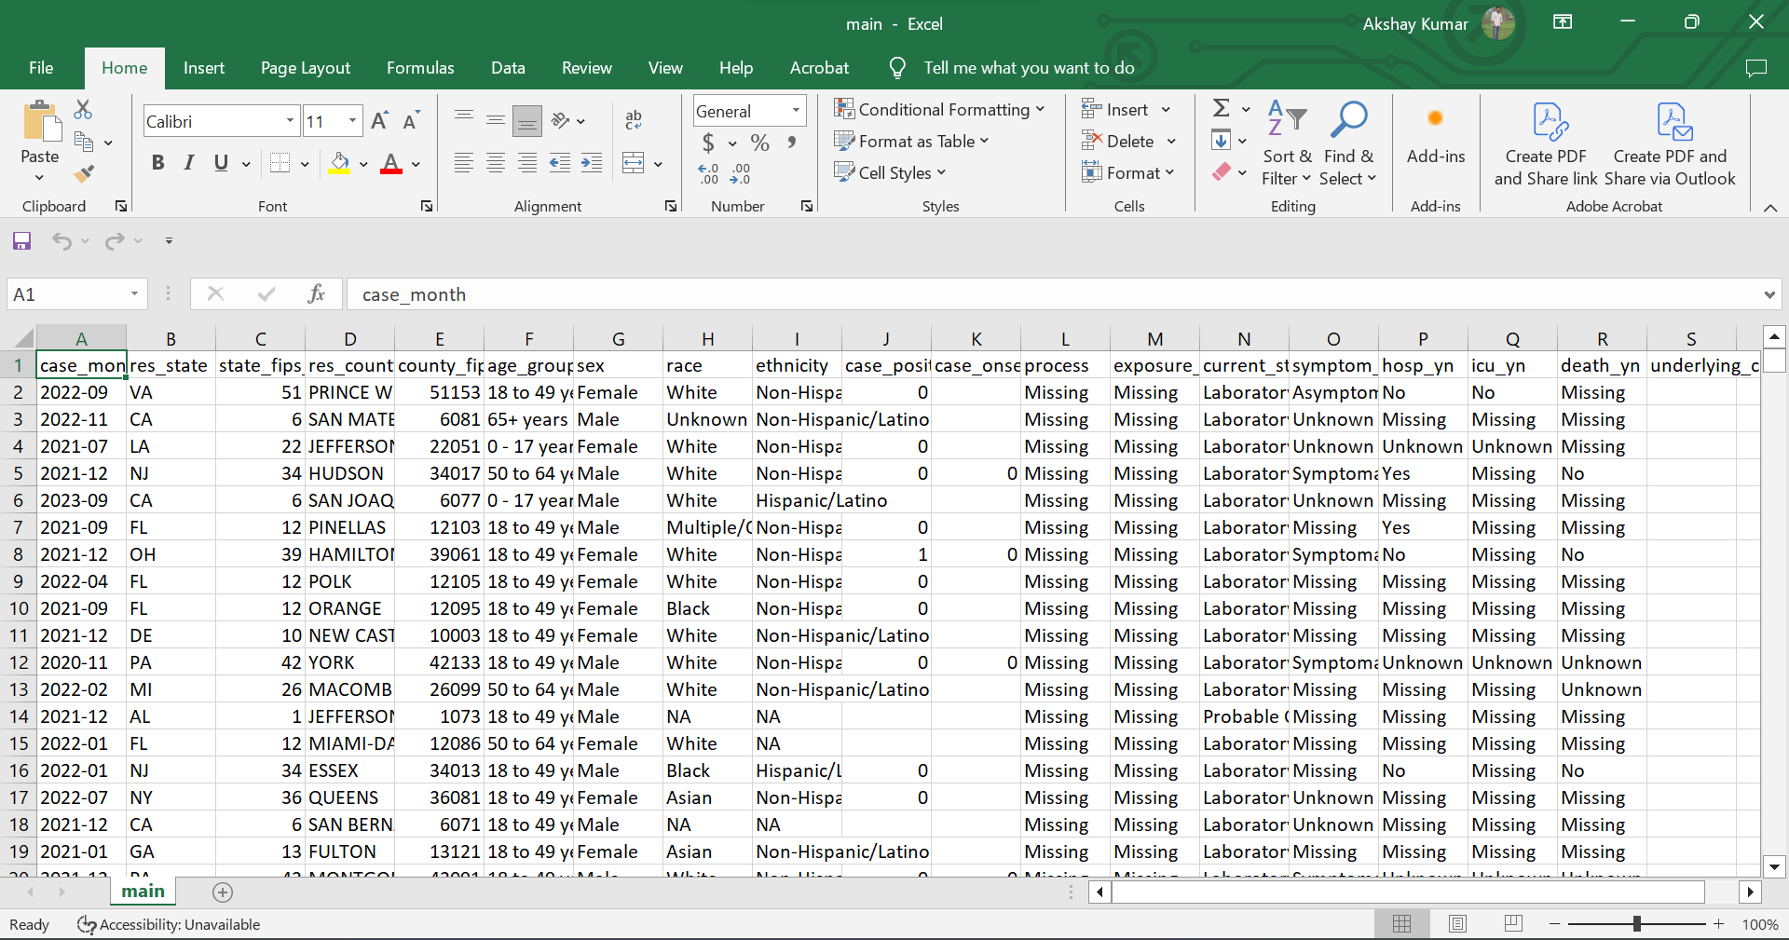

Slide 5
Data Collection from sources
Validation and Cleaning of data
Copy data into Hadoop DFS
Run Mapper and Reducer
Analyze the results

Slide 6
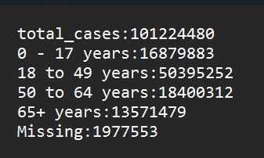
Number of cases registered as per age group
Percentage of cases in as per age group
0 – 17 years => 16.67%
18 - 49 years => 49.78%
50 to 64 years => 18.17%
65+ years => 13.40%
Missing data => 1.9%
From the analysis it is evident that age group 18 – 49 has most number of cases.

Slide 7
Death rate as per age group
Number of deaths registered in a group / Number of cases registered for a particular group
65 + years => 3.1%
50 – 64 years => 0.23%
18 – 49 years => 0.1%
0 – 17 years => 0
From the results it is clear that people with 65+ years have more risk.

Slide 9
Number of covid cases in different states
{'AK': 302397, 'AL': 1710458, 'AR': 1021595, 'AZ': 2525978, 'CA': 12489810, 'CO': 1805662, 'CT': 728115, 'DC': 179229, 'DE': 330578, 'FL': 5927547, 'GA': 2707870, 'GU': 54224, 'HI': 331040, 'IA': 503717, 'ID': 529487, 'IL': 4212196, 'IN': 2104148, 'KS': 952290, 'KY': 1739148, 'LA': 1668554, 'MA': 2292748, 'MD': 1655280, 'ME': 327523, 'MI': 3004872, 'MN': 1819165, 'MO': 1821721, 'MS': 477972, 'MT': 267982, 'NA': 1704, 'NC': 3543183, 'ND': 294373, 'NE': 531004, 'NH': 383080, 'NJ': 3192933, 'NM': 701436, 'NV': 819245, 'NY': 7214608, 'OH': 3528174, 'OK': 772176, 'OR': 977833, 'PA': 3613663, 'PR': 178400, 'RI': 341591, 'SC': 1960618, 'SD': 302659, 'TN': 2557214, 'TX': 9172843, 'UT': 1112638, 'VA': 2363374, 'VI': 24635, 'VT': 143988, 'WA': 2000719, 'WI': 1800516, 'WV': 11002, 'WY': 189564}

Slide 10
Number of deaths registered in each state
{'AK': 109, 'AL': 5189, 'AR': 3789, 'AZ': 22987, 'CA': 72269, 'CO': 4639, 'CT': 5407, 'DC': 712, 'FL': 50381, 'GA': 897, 'IA': 907, 'ID': 1900, 'IL': 23782, 'IN': 6271, 'KS': 4368, 'KY': 5986, 'LA': 2616, 'MA': 16640, 'MD': 2908, 'ME': 507, 'MI': 18872, 'MN': 6117, 'MO': 8499, 'MS': 1027, 'MT': 1319, 'NC': 5387, 'ND': 1031, 'NE': 222, 'NH': 1120, 'NJ': 20755, 'NM': 2576, 'NV': 10624, 'NY': 42682, 'OH': 22517, 'OK': 3920, 'OR': 1540, 'PA': 23112, 'PR': 4893, 'RI': 605, 'SC': 5385, 'SD': 81, 'TN': 9428, 'TX': 21050, 'UT': 1339, 'VA': 6030, 'VT': 44, 'WA': 5278, 'WI': 5400, 'WY': 344}

Slide 11
Future Exploration?

Slide 12


